Slide 1

KS2 Reading workshop

Slide 2
Aims
What have we achieved as a school?
What are the raised expectations?
How does knowledge of vocabulary impact upon reading?
How do we teach your child to read and develop their comprehension? How do we assess reading?
How can I support my child to develop their reading and comprehension at home?
Q&A

Slide 3
Where are we as a school?
2016 – 2017 – 77.4% of children ‘expected’ standard or better
2017 – 2018 – 61.3% of children ‘expected’ standard or better
2018 – 2019 – 59.4% of children ‘expected’ standard or better

Slide 4
Raised Expectations – Test Content
The English reading test now has a greater focus on fictional texts.
Three texts are given, progressing in length and difficulty. Children are given one hour to read and complete questions.
The combined word count of the three texts in May 2019 was 2,168. This is the longest a SAT paper has ever been and is just shy of the 2,300 maximum word limit set by the government.
If a child has an average reading rate of 90 words per minute, this means that by the time they had read the entire test paper, they only have one minute to answer each question.

Slide 5
How We Identify Gaps
When children enter Year 3, they already have a score received at the end of KS1. They are assessed again at the start of the year to ensure they are still working at this level.
Children who have read continuously over the summer holidays will have an increased reading speed and will be able to access the texts of their year group easier – fluency and speed is a barrier to understanding.
Children are formally assessed by the teacher a total of three times over the year. Not only does this provide us with an ability to identify gaps in understanding and speed of reading, but also gets children used to the style of questioning they will face in subsequent years.

Slide 6
How We Are Trying To ‘Bridge the Gaps’
Promote a love of reading by the use of termly raffle draws and the ‘Golden Ticket’ scheme.
Use of the Lexia programme to support (where appropriate, based on need).
Extra fluency reading groups with TA or other adults (based on need).
Buddy Reading to be started in January (initially Y2/Y5 classes).
Read Theory comprehension homework (where appropriate).
Whole class reading (more on this later).
Explicit teaching of vocabulary.

Slide 7
How do we teach your child to read and develop their comprehension at KS2?
Whole Class Reading
Maximises time spent on quality discussion and analysis of text.
Children have the opportunity to hear correct fluency and punctuation modelled to them. Children do also read aloud / independently.
Prepare – Read / React – Explore – Process

Slide 8
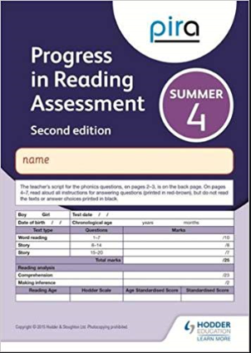

What Level Should Your Child Be Working At?

Slide 9
How can I support my child to develop their reading and comprehension skills?
Essentially, there has to be a strong partnership between home and school.
Reading skills are not taught after your child leaves Primary school. It is expected that children can read fluently and understand what they have written.
If your child is saying their book is too boring, do they actually understand it? Check the understanding of the vocabulary.

Slide 10

1. Vocabulary support. Don’t be afraid of picture books in any year group!
Often as the children enter Y3, it becomes a rush to move ‘up’ the spots. Children want to choose small novels over picture books, yet most picture books have a wealth of vocabulary which needs to be explored and discussed in order to be understood and enjoyed.
When a previous Y3 class read this with Mrs Cook, all could decode (read) most of the words and sounded fluent, yet when discussion began, it was clear that much of the vocabulary was new and the children needed support to ensure a full understanding.
Without this support there are very clear gaps and misunderstandings.

Slide 11
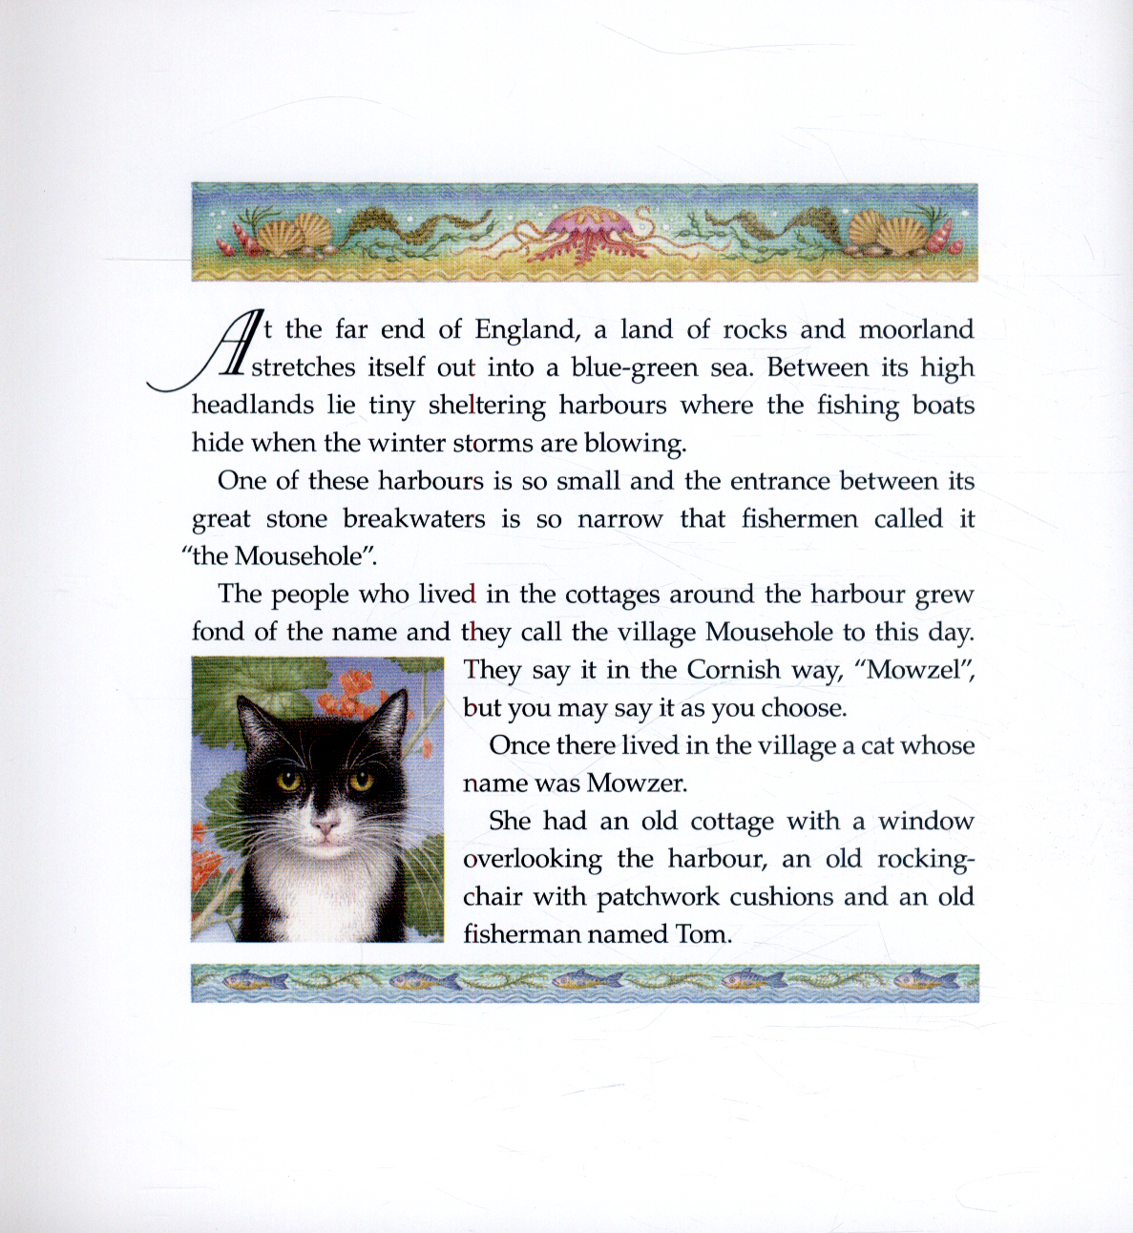
Understanding of vocabulary needs supporting at school and at home.
moorland
headland
sheltering harbours
breakwaters
narrow
cottage
grew fond of
patchwork

Slide 12

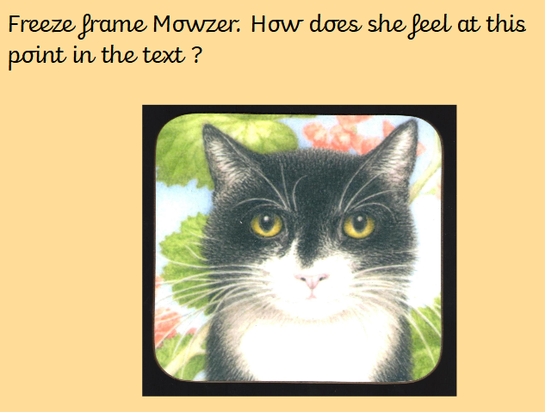
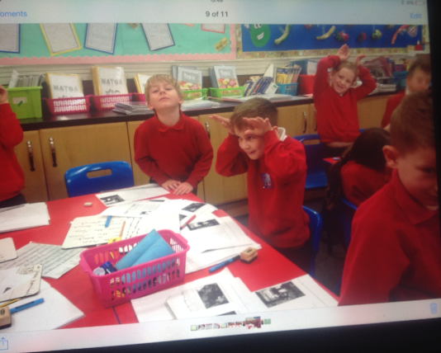

The discussion of language and practical classroom activities enable the children to apply their knowledge and understanding in the ‘Process’ aspect of the lesson.

Slide 13
Explicitly Teaching Vocabulary
Focus word identified (topic related)
Hear the word pronounced, children repeat.
Clap the syllables.
Look at a definition, draw the meaning of the word.
Rewards for use in spoken language, in written work, if the children hear adults in class using it.
Displayed on working walls so children can refer back if needed.

Slide 14



Shaun Tan’s beautifully illustrated books are fantastic especially for older Key Stage 2 children. Illustrations allow for pure engagement and enjoyment – a picture is worth a thousand words! Stimulating images promotes discussion which then allows the child to become the storyteller (visual literacy). If your child is fazed by large amounts of text or is a particularly reluctant reader, these kinds of books are a perfect starting point.

Slide 15

Even though the text on this page is minimal, the arrangement and diminishing size of it mimics how the machine is drawing and luring Tristan in – a valuable point of discussion.
You have to physically bend in closer to read the very end – just like Tristan feels compelled to enter the machine.

Slide 16

2. Asking effective questions
Your parent handout booklet has lots of different questions to help you effectively question your child. In order to have good comprehension skills, your child needs to develop their ability to respond to all of these:
Literal Inference Deduction / Opinion
Looking and
finding
The clue question – reading between the lines
Goes beyond the text – making connections to known facts / general knowledge

Slide 17


3. Making reading enjoyable
Join and visit a library.
Enjoy a wide range of reading materials: books, picture books (all ages!), newspapers, magazines, E-books and audio books.
Take it in turns reading – your child to you and also vice versa – this helps to model correct expression and allows for the discussion of vocabulary.

Slide 18
Thank you for your time.
If you have any questions, please feel free to come and chat to us or email the office to forward on to Mrs Harris, Miss Bailey, Miss Matthews or Mrs Cook:
info@parkhouse.derbyshire.sch.uk

