Slide 1



LIFE/work balance
We have started a #LIFEworkbalance campaign and we need your help to complete our LIFE/work balance survey.
We hope to publish the results soon, so please give 15 minutes of your time to help us get a true picture of school life.
Want to be a part of this campaign? Take the survey on our website and share it with your colleagues!
© Classroom Secrets Limited 2019

Slide 2
Year 1 – Summer Block 6 – Time – Writing Time
About This Resource:
This PowerPoint has been designed to support your teaching of this small step. It includes a starter activity and an example of each question from the Varied Fluency and Reasoning and Problem Solving resources also provided in this pack. You can choose to work through all examples provided or a selection of them depending on the needs of your class.
National Curriculum Objectives:
Mathematics Year 1: (1M2) Measure and begin to record time (hours, minutes, seconds)
More Year 1 Time resources.
Did you like this resource? Don’t forget to review it on our website.
© Classroom Secrets Limited 2018

Slide 3
Year 1 – Summer Block 6 – Time
Step 5: Writing Time
© Classroom Secrets Limited 2018

Slide 4
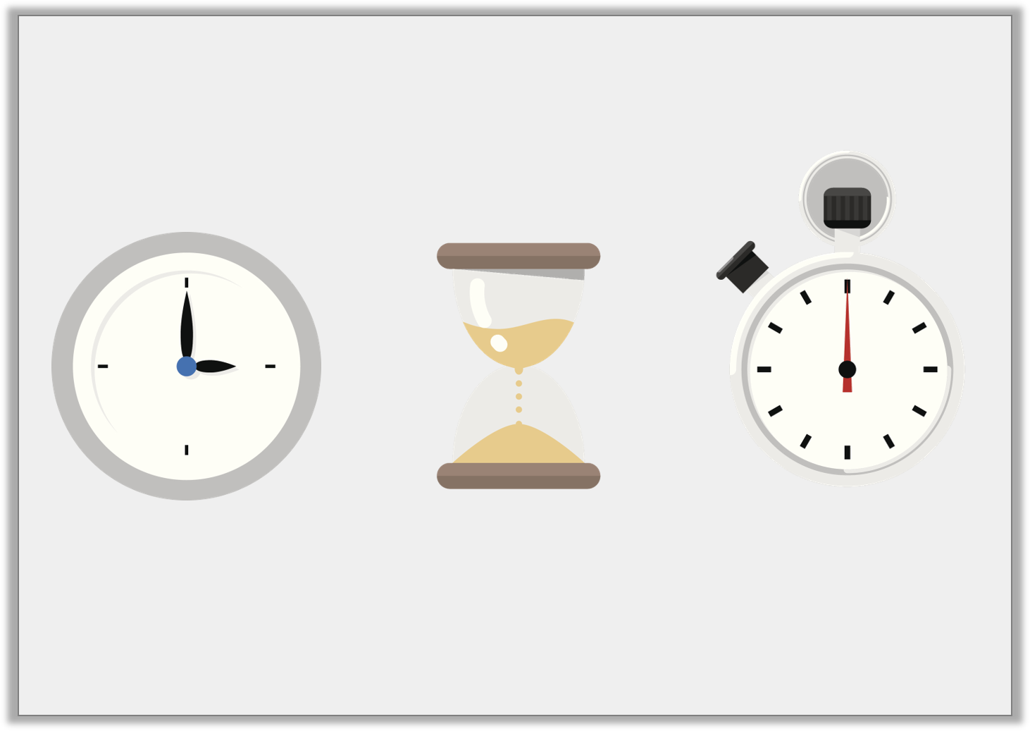
Introduction
What activities could you measure with the following items?
© Classroom Secrets Limited 2018

Slide 5
Introduction
What activities could you measure with the following items?
Activities in hours. For example, how long you spend at school.
Activities in seconds or minutes. For example, how many jumps you could so in a minute.
Activities in seconds or minutes. For example, how long it takes you to run around a park.
© Classroom Secrets Limited 2018

Slide 6
Varied Fluency 1
Write “seconds”, “minutes” or “hours” in the box to complete the sentence.
Maisy went to her swimming lesson for 2 .
© Classroom Secrets Limited 2018

Slide 7
Varied Fluency 1
Write “seconds”, “minutes” or “hours” in the box to complete the sentence.
Maisy went to her swimming lesson for 2 .
hours
© Classroom Secrets Limited 2018

Slide 8
Varied Fluency 2
Match the times to the activities.
Wash your hands. |  | Hours
Go to a school disco. |  | Minutes
Have a shower. |  | Seconds
© Classroom Secrets Limited 2018

Slide 9
Varied Fluency 2
Match the times to the activities.
Wash your hands. |  | Hours
Go to a school disco. |  | Minutes
Have a shower. |  | Seconds
© Classroom Secrets Limited 2018

Slide 10
Varied Fluency 3
Tick the odd one out if you were measuring in minutes.
Sleeping at night.
Playing a game of hide and seek.
Timing how long it takes you to run around the playground.
© Classroom Secrets Limited 2018

Slide 11
Varied Fluency 3
Tick the odd one out if you were measuring in minutes.
Sleeping at night.
Playing a game of hide and seek.
Timing how long it takes you to run around the playground.
✓
© Classroom Secrets Limited 2018

Slide 12
Varied Fluency 4
Would these activities be measured in
hours, minutes or seconds?
Get in the car.
Sing a full song.
Go for a long car journey.
Open a car door.
© Classroom Secrets Limited 2018

Slide 13
Varied Fluency 4
Would these activities be measured in
hours, minutes or seconds?
Get in the car. | Seconds
Sing a full song. | Minutes
Go for a long car journey. | Hours
Open a car door. | Seconds
© Classroom Secrets Limited 2018

Slide 14
Reasoning 1
Are these statements always or sometimes true?
Washing clothes in the washing machine is
measured in minutes.
Cooking a pizza is measured in minutes.
© Classroom Secrets Limited 2018

Slide 15
Reasoning 1
Are these statements always or sometimes true?
Washing clothes in the washing machine is
measured in minutes.
Sometimes, because it depends on the type of wash.
Some can take minutes but some can be more than an hour.
Cooking a pizza is measured in minutes.
Always, because if a pizza is cooked for seconds it will still be cold. If it is cooked for hours it will burn.
© Classroom Secrets Limited 2018

Slide 16
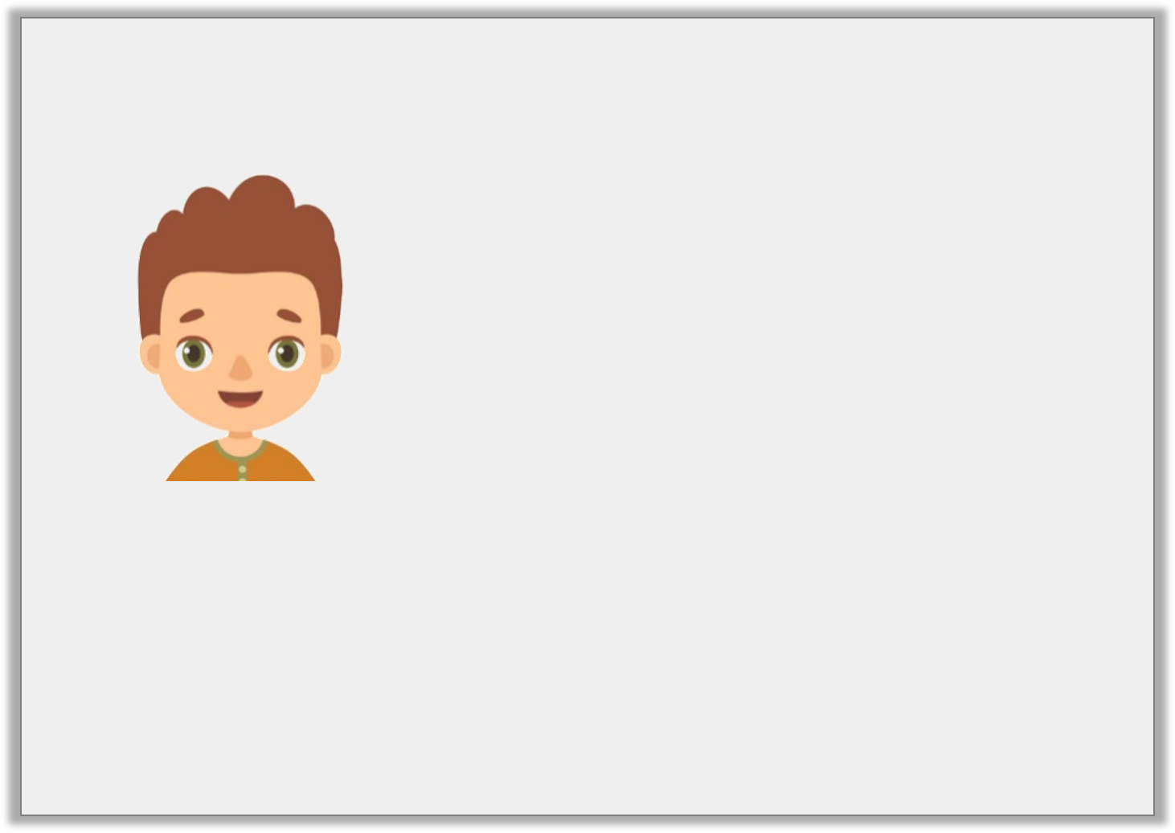
Reasoning 2
Bob says,
Is this a sensible unit of time to use?
Is this the correct equipment to use?
Why?
I’m going to walk to the local shop a mile away.
I’m going to use my wrist-watch and measure the time it takes in seconds.
© Classroom Secrets Limited 2018

Slide 17
Reasoning 2
Bob says,
Is this a sensible unit of time to use?
No, because…
Is this the correct equipment to use?
Yes, because…
Why?
I’m going to walk to the local shop a mile away.
I’m going to use my wrist-watch and measure the time it takes in seconds.
© Classroom Secrets Limited 2018

Slide 18
Reasoning 2
Bob says,
Is this a sensible unit of time to use?
No, because walking to the shop is likely to take minutes.
Is this the correct equipment to use?
Yes, because it is easy to measure minutes on a wrist-watch.
I’m going to walk to the local shop a mile away.
I’m going to use my wrist-watch and measure the time it takes in seconds.
© Classroom Secrets Limited 2018

Slide 19
Problem Solving 1
Use some buttons and a piece of string.
How many beads do you think you can thread
on the string in 30 seconds?
Now try it.
How many more beads could you
thread in:
1 minute?
1 minute and 30 seconds?
Was your estimation correct?
© Classroom Secrets Limited 2018

Slide 20
Problem Solving 1
Use some buttons and a piece of string.
How many beads do you think you can thread
on the string in 30 seconds?
Now try it.
How many more beads could you
thread in:
1 minute?
1 minute and 30 seconds?
Was your estimation correct?
Answers will vary.
© Classroom Secrets Limited 2018

