Slide 1
Lesson 2: Directions
Save a copy
Year 1 – Moving a robot
Notes:
Last updated: 01-07-20
This resource is available online at ncce.io/pg1a-2-s. Resources are updated regularly — please check that you are using the latest version.
This resource is licensed under the Open Government Licence, version 3. For more information on this licence, see ncce.io/ogl.

Slide 2
Lesson 2
Objectives
To act out a given word
I can follow an instruction
I can recall words that can be acted out
I can give directions

Slide 3
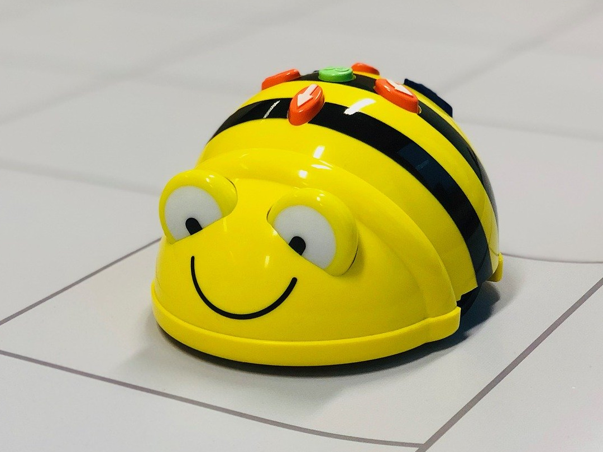
Instructions
Introduction
Last lesson we explored our robot.
We tried the buttons out.
We gave the robot some instructions to follow. Can you remember how we did that?
Notes:
https://pixabay.com/photos/beebot-bee-robot-technology-4096410/

Slide 4

Follow instructions
Activity 1
We’re going to try following instructions ourselves.
Listen carefully and try to follow your teacher's instructions.
Sit
Notes:
https://pixabay.com/illustrations/fax-white-male-3d-model-isolated-1889017/

Slide 5

Can you think of more instructions?
Activity 2
Can you think of more words that can be acted out?
Talk to a partner about it for one minute.
?
Notes:
https://pixabay.com/illustrations/fax-white-male-3d-model-isolated-1889017/

Slide 6

Can you give clear instructions?
Activity 3
Give your partner some instructions to follow.
Notes:
https://pixabay.com/illustrations/white-male-3d-man-isolated-3d-1871375/

Slide 7

Giving directions
Activity 4
Which instructions could you use to direct your partner around the room?
Hint: Think about the buttons on your robot. Could you use those as instructions?
Notes:
https://pixabay.com/illustrations/german-males-3d-model-isolated-3d-2566426/

Slide 8
Giving directions
Activity 4
Give your partner instructions to follow so that they move around.
Notes:
https://pixabay.com/illustrations/german-males-3d-model-isolated-3d-2566426/

Slide 9
Moving around
Plenary
What was it like giving your partner instructions?
What was it like acting out the instructions?
How did it compare with using the floor robot?

Slide 10

Assessment
How confident are you? (1–3)
I can follow an instruction
I can recall words that can be acted out
I can give directions
3 – Very confident
2 – Unsure
1 – Not confident
Notes:
Image source: https://pixabay.com/vectors/thumb-up-hand-like-confirm-go-top-307176

Slide 11
Next lesson
Summary
In this lesson, you…
Thought about words that can be used as instructions
Gave each other instructions and followed instructions
Next lesson, you will…
Use commands to make the floor robot move forwards and backwards

