Slide 1
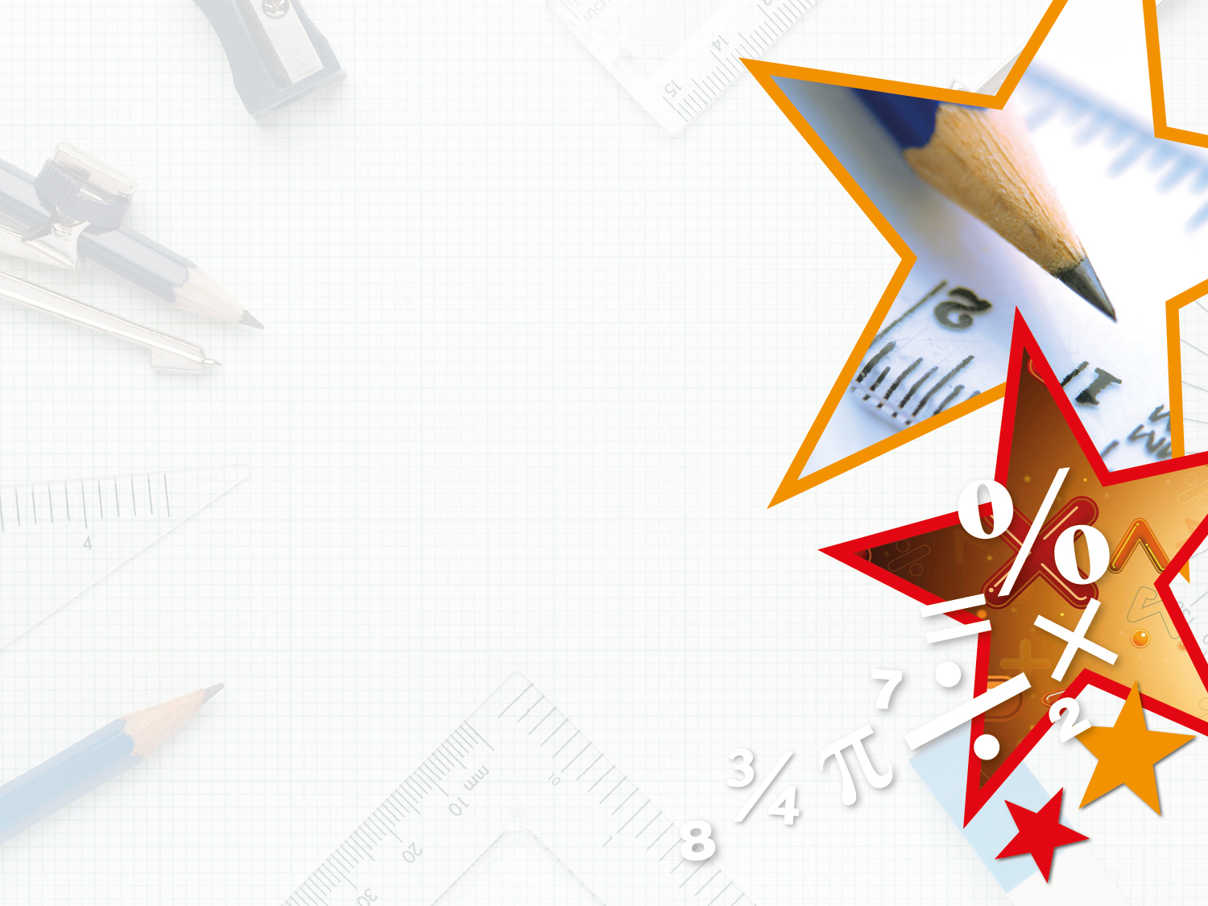


We have started a #LIFEworkbalance campaign and we need your help to complete our LIFE/work balance survey.
We hope to publish the results soon, so please give 15 minutes of your time to help us get a true picture of school life.
Want to be a part of this campaign? Take the survey on our website and share it with your colleagues!
© Classroom Secrets Limited 2019

Slide 2
Year 1 – Summer Block 6 – Time – Time to the Half Hour
About This Resource:
This PowerPoint has been designed to support your teaching of this small step. It includes a starter activity and an example of each question from the Varied Fluency and Reasoning and Problem Solving resources also provided in this pack. You can choose to work through all examples provided or a selection of them depending on the needs of your class.
National Curriculum Objectives:
Mathematics Year 1: (1M4a) Tell the time to the hour and half past the hour and draw the hands on a clock face to show these times
More Year 1 Time resources.
Did you like this resource? Don’t forget to review it on our website.
© Classroom Secrets Limited 2018

Slide 3
Year 1 – Summer Block 6 – Time
Step 4: Time to the Half Hour
© Classroom Secrets Limited 2018

Slide 4
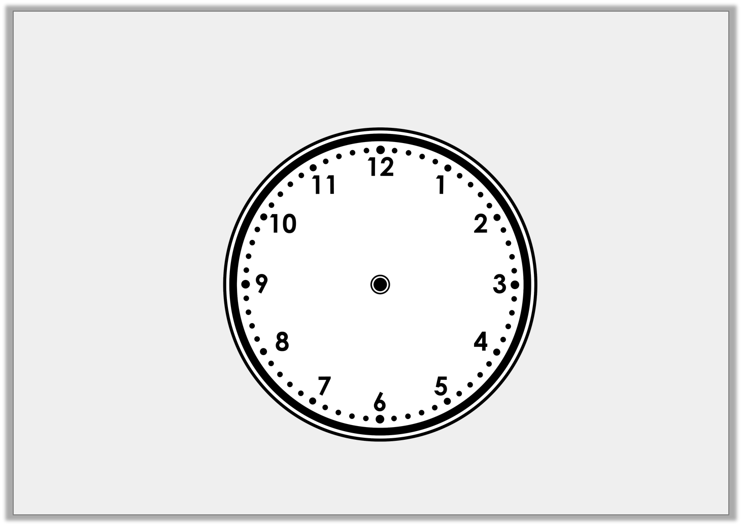
Introduction
The hour hand is missing from the clock face.
What time could it be?
© Classroom Secrets Limited 2018

Slide 5
Introduction
The hour hand is missing from the clock face.
What time could it be?
It could be half past any hour.
© Classroom Secrets Limited 2018

Slide 6
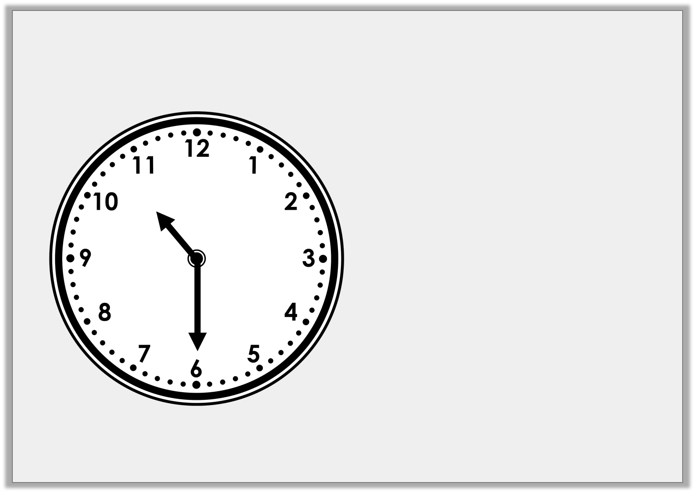
Varied Fluency 1
What time does the clock show?
Half past 9
Half past ten
Half past 6
© Classroom Secrets Limited 2018

Slide 7
Varied Fluency 1
What time does the clock show?
Half past 9
Half past ten
Half past 6
© Classroom Secrets Limited 2018

Slide 8
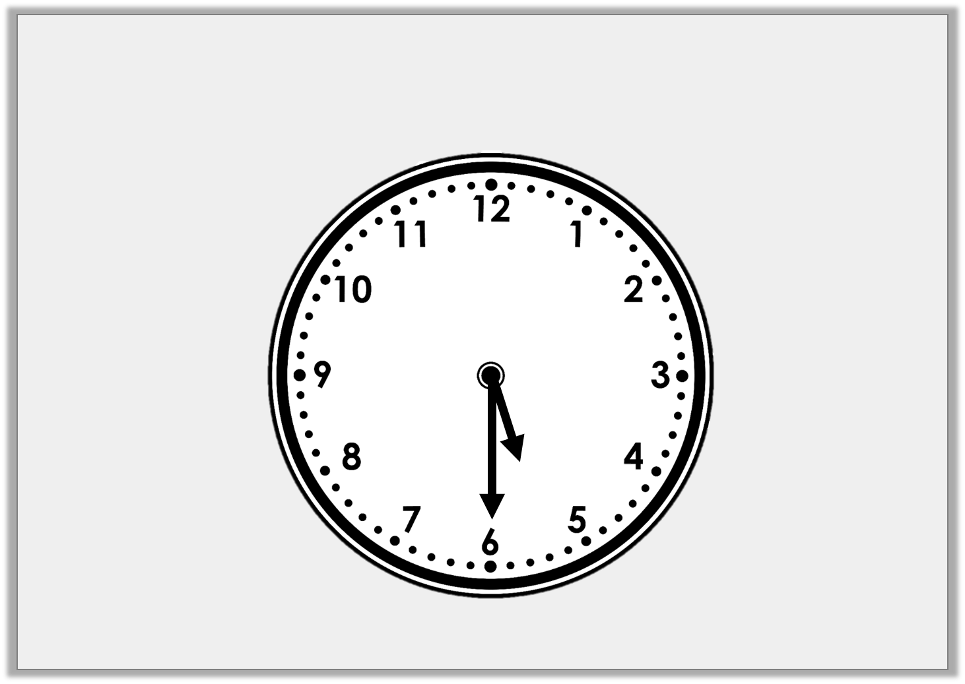
Varied Fluency 2
True or false? The clock shows half past five.
© Classroom Secrets Limited 2018

Slide 9
Varied Fluency 2
True or false? The clock shows half past five.
True
© Classroom Secrets Limited 2018

Slide 10
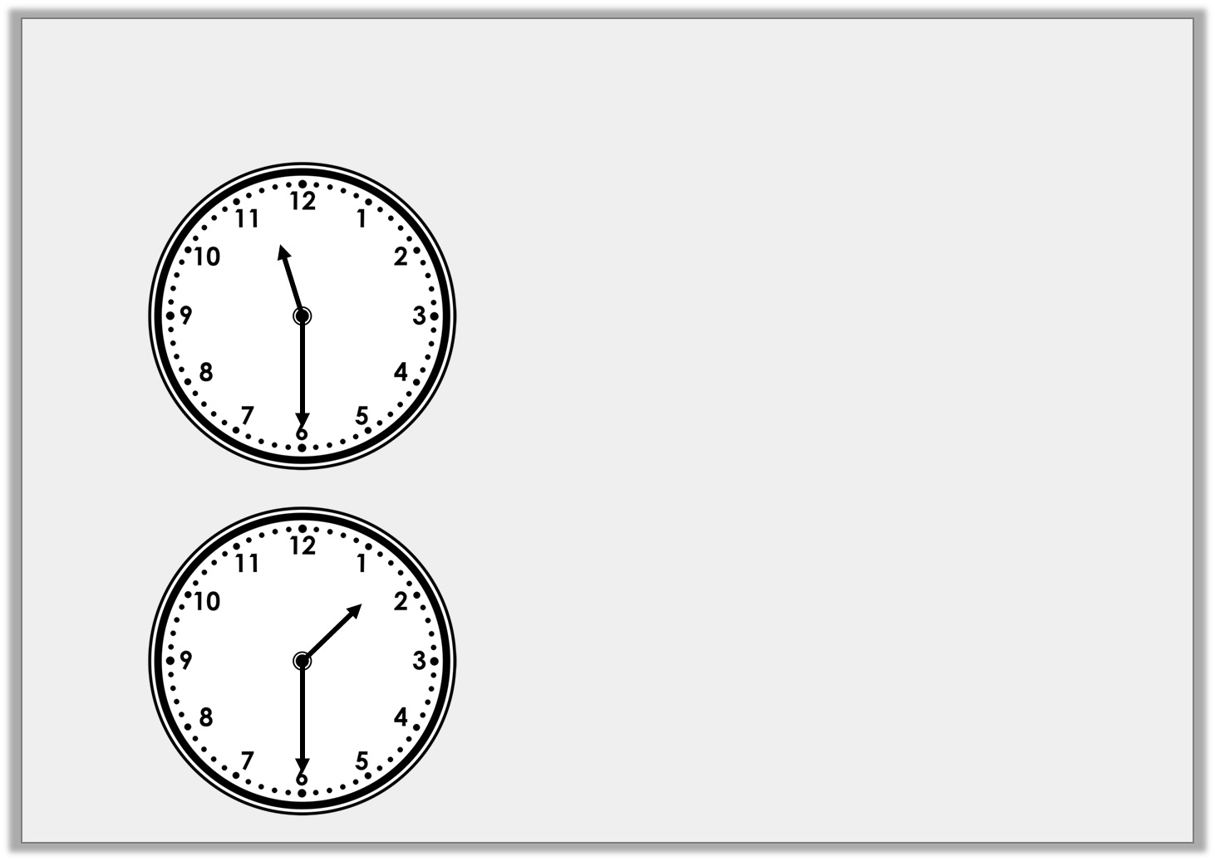
Varied Fluency 3
Draw a line to match the clocks to the correct written time.
Half past 11
Half past one
Half past ten
© Classroom Secrets Limited 2018

Slide 11
Varied Fluency 3
Draw a line to match the clocks to the correct written time.
Half past 11
Half past one
Half past ten
© Classroom Secrets Limited 2018

Slide 12
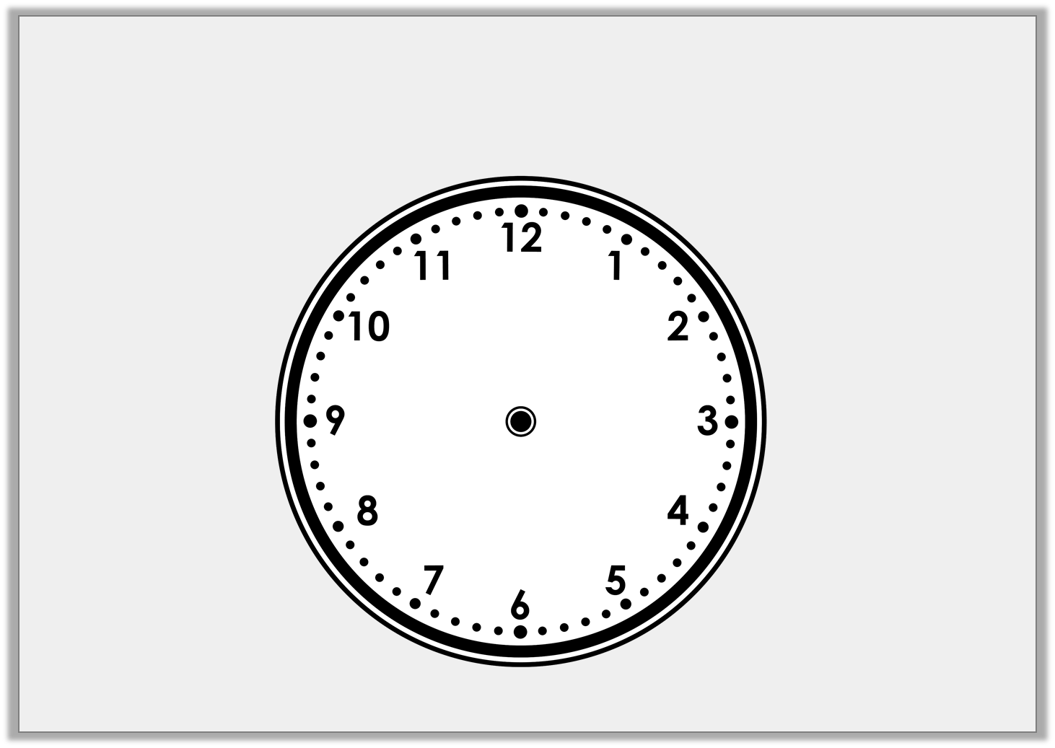
Varied Fluency 2
Draw the hour hand and the minute hand
on to the clock face to show the time half past 3.
© Classroom Secrets Limited 2018

Slide 13
Varied Fluency 2
Draw the hour hand and the minute hand
on to the clock face to show the time half past 3.
© Classroom Secrets Limited 2018

Slide 14
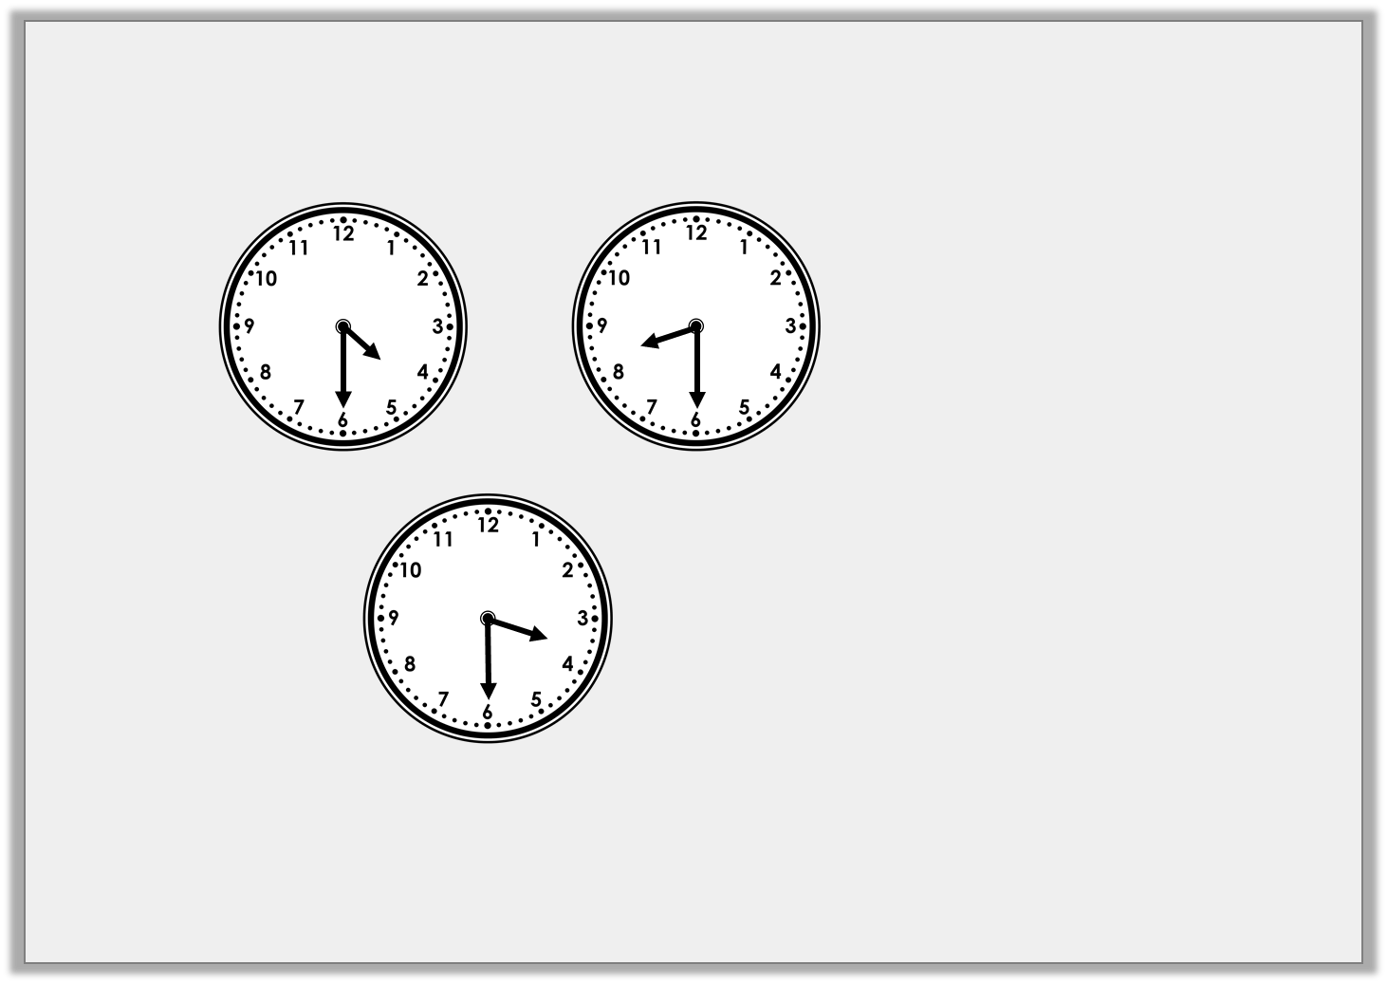
Reasoning 1
Which is the odd one out? Explain your answer.
A
B
C
Half past 3
D
E
Half past 8
© Classroom Secrets Limited 2018

Slide 15
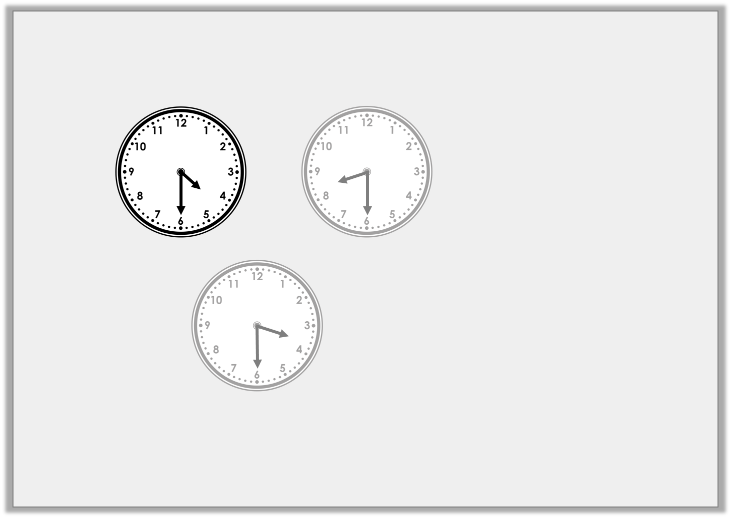
Reasoning 1
Which is the odd one out? Explain your answer.
A is the odd one out because…
A
B
C
Half past 3
D
E
Half past 8
© Classroom Secrets Limited 2018

Slide 16
Reasoning 1
Which is the odd one out? Explain your answer.
A is the odd one out because it is the only clock which shows half past 4. B and E show half past 8 and C and D show half past 3.
A
B
C
Half past 3
D
E
Half past 8
© Classroom Secrets Limited 2018

Slide 17
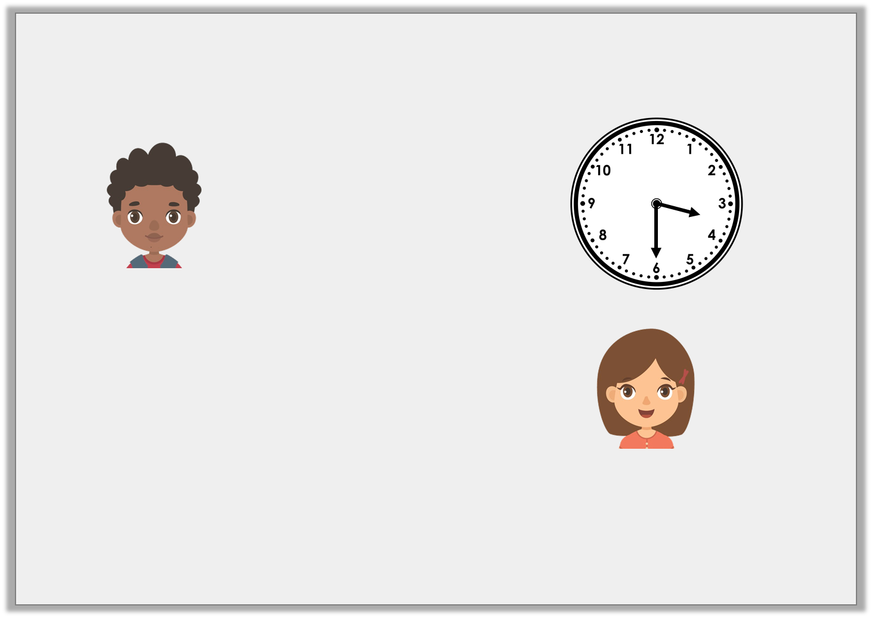
Reasoning 2
Samuel and Ellan are discussing the time.
Who is correct? Explain your answer.
It is half past three.
Samuel
No, it is half past four.
Ellan
© Classroom Secrets Limited 2018

Slide 18
Reasoning 2
Samuel and Ellan are discussing the time.
Samuel is correct because…
It is half past three.
Samuel
No, it is half past four.
Ellan
© Classroom Secrets Limited 2018

Slide 19
Reasoning 2
Samuel and Ellan are discussing the time.
Samuel is correct because the hour hand is pointing in between the 3 and the 4 so the time shown is half past three.
It is half past three.
Samuel
No, it is half past four.
Ellan
© Classroom Secrets Limited 2018

Slide 20
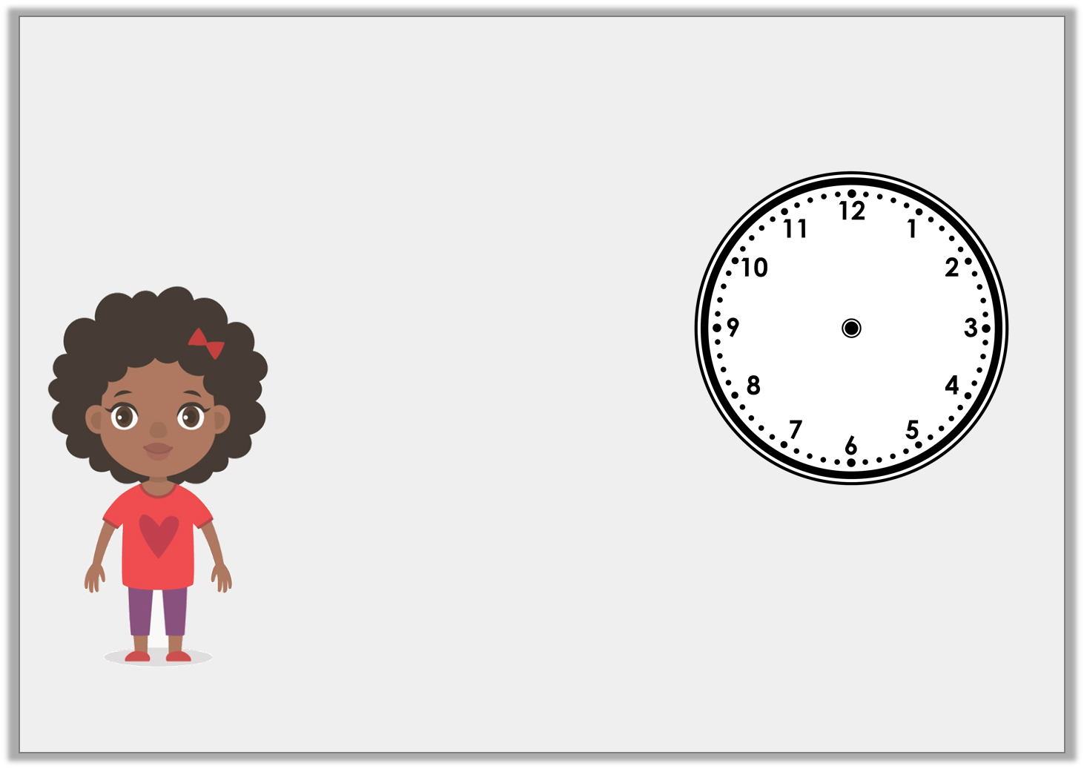
Problem Solving 1
Nicola is describing the time. Use the clues to work out what time Nicola is thinking of.
The minute hand is pointing to the 6. The hour hand is pointing in between the 11 and the 12.
© Classroom Secrets Limited 2018

Slide 21
Problem Solving 1
Nicola is describing the time. Use the clues to work out what time Nicola is thinking of.
The time Nicola is thinking of is half past 11.
The minute hand is pointing to the 6. The hour hand is pointing in between the 11 and the 12.
© Classroom Secrets Limited 2018

